Slide 1


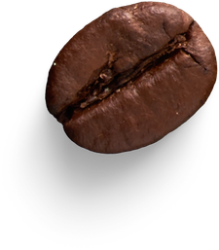
By Esihle Nketeba
BRIGHTCOFFEE SHOP
PRESENTATION

Slide 2
02
Insight| Total Revenue by MonthName
Revenue increase consistently every month from January to June.
This shows steady business growth with no decline periods.
Growth appears linear and healthy, not volatile

Slide 3

Insight
Hell’s Kitchen has the highest contribution.
All locations are performing at the similar level
The business is not dependent on a single store
03

Slide 4

Revenue Analysis By TIME BUCKET
04
Morning drives the majority of revenue
Afternoon has moderate performance
Evening is the weakest period

Slide 5

Revenue by DAY NAME
Insights
05
All days contribute roughly 14%–15% each
No major spikes or drops
The business has consistent daily demand
Revenue is stable and predictable

Slide 6

06
Insight
Sales are evenly distributed across stores
All stores contribute almost equally to total sales
No location is underperforming

Slide 7
Insight
07
Coffee is the dominant revenue driver. It is by far the highest.
It contributes more than any other category combined (almost)
Tea is a major secondary driver
This indicates diverse customer preferences

Slide 8
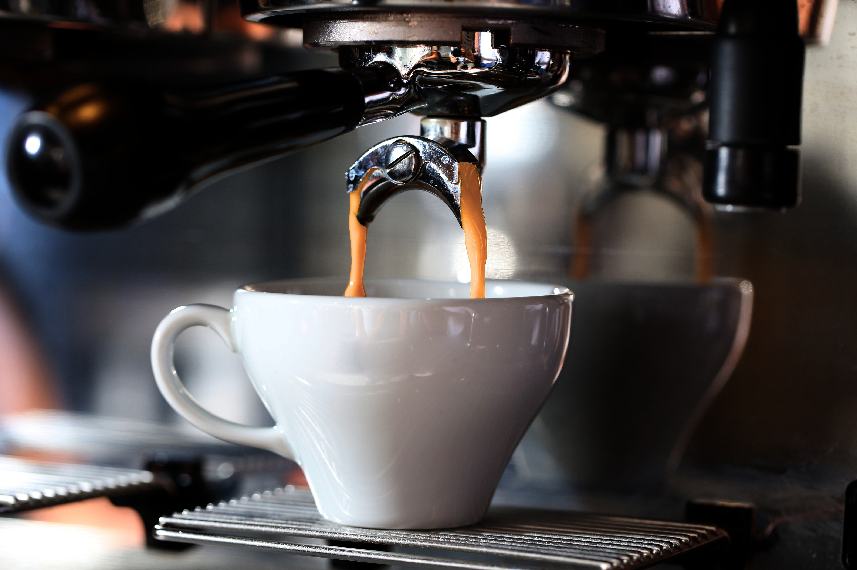
08
Insight
Peak revenue occurs in the morning (8 am – 10 am)
Sharp drop after 10 am
Morning rush ends quickly
Midday is stable but moderate (12 pm – 4 pm)
Evening decline (5 pm – 8 pm)

Slide 9
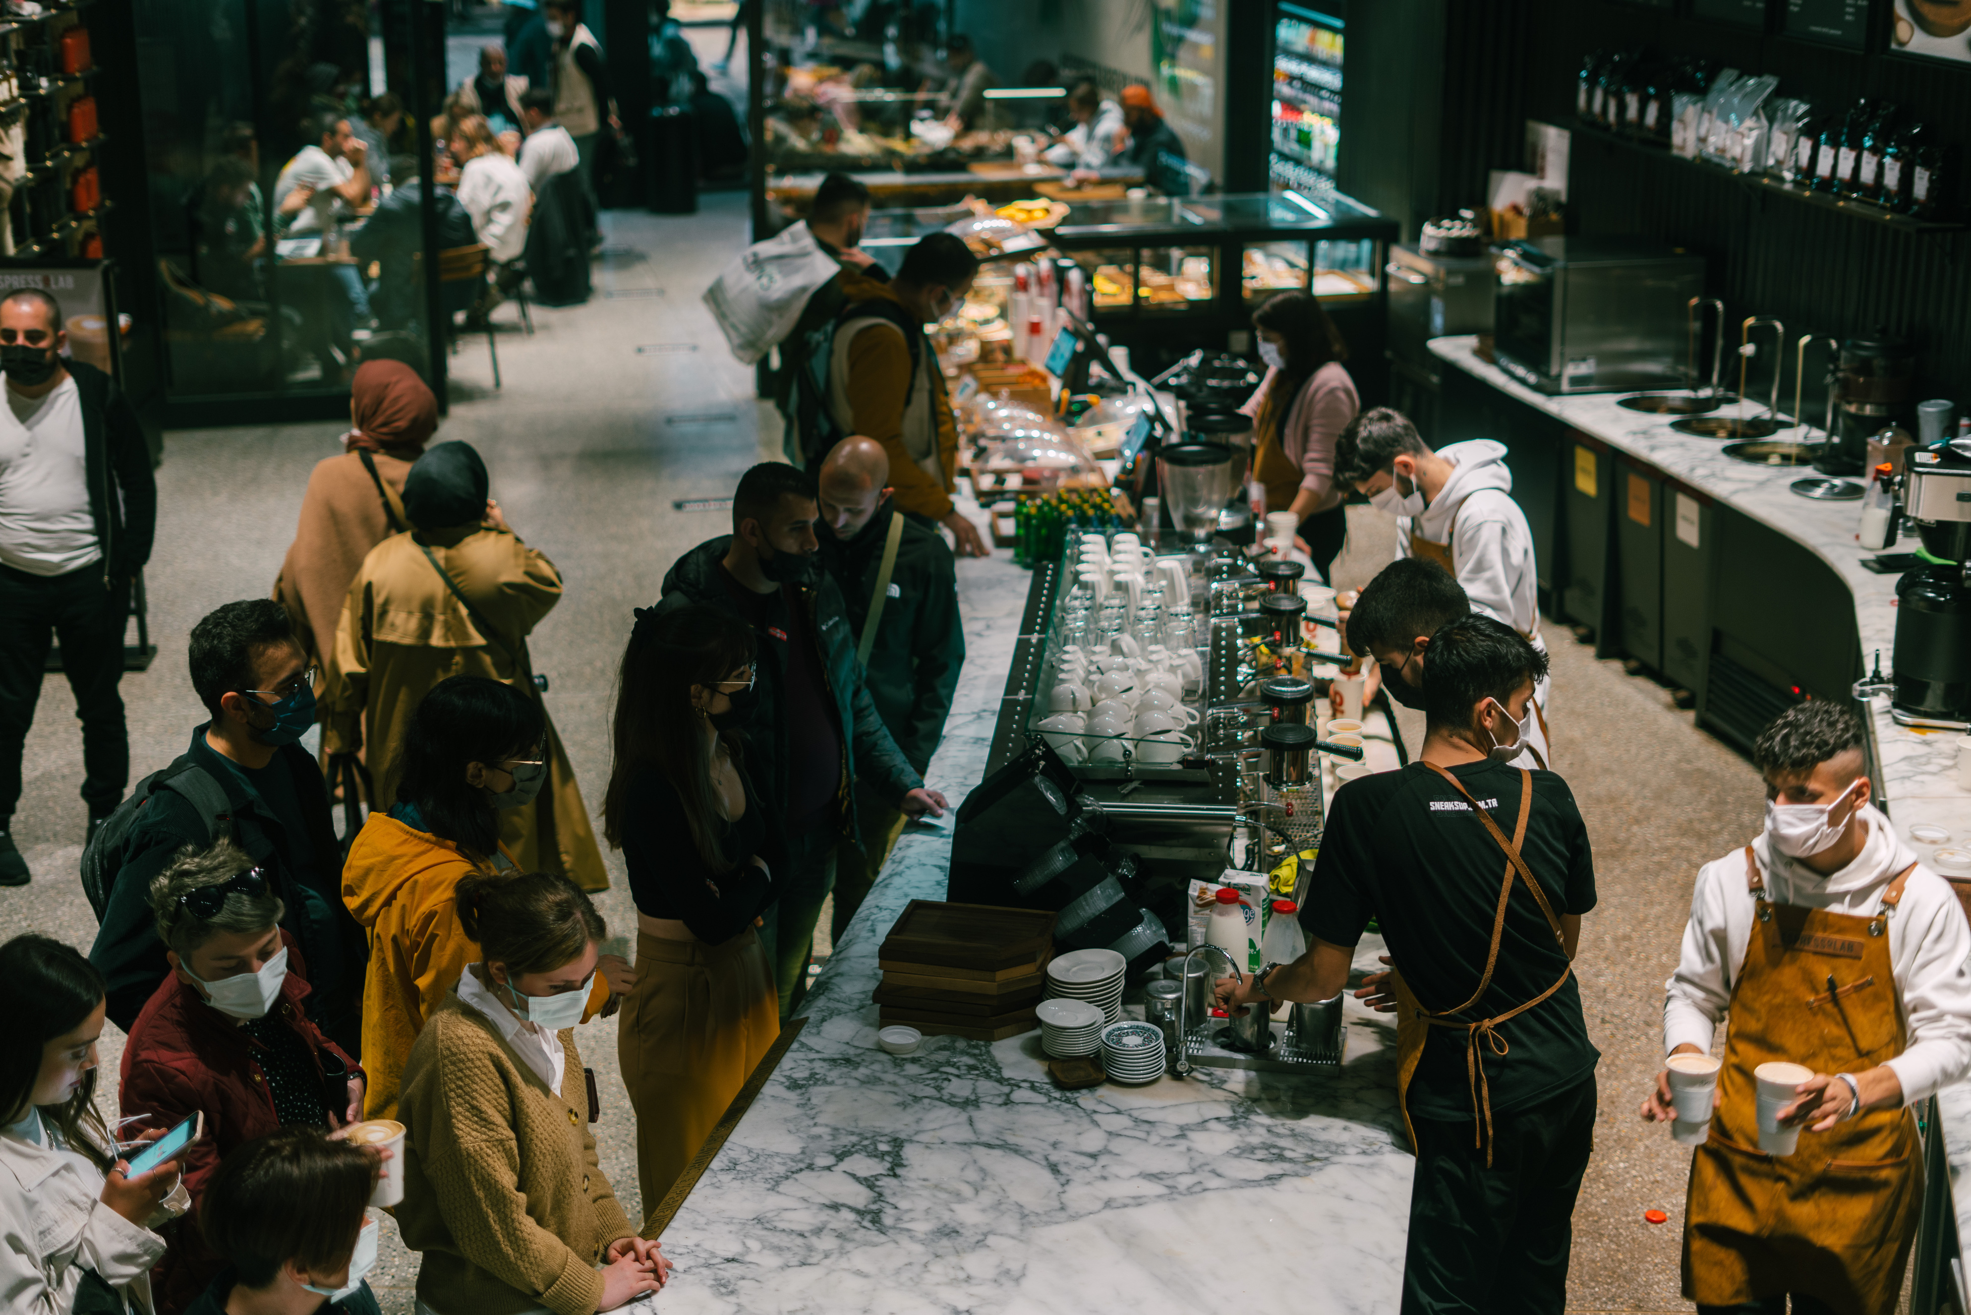
Bucket Spenders
09
Insight
Low Spenders generate the most revenue across all locations
Higher Spenders are fewer but still important.
Lower Manhattan attracts more premium customers.
Potential for luxury or premium offerings in that location.

Slide 10
Bright Coffee Shop
Recommendations
Focus on top-selling products (coffee & tea).
Increase average order value through bundles and upselling.
Convert low spenders into higher spenders
Maximize morning peak hours (8-10 am).
Improve evening sales with promotions

Slide 11
Bright Coffee Shop
LET’S BREW TOGETHER

